Slide 1

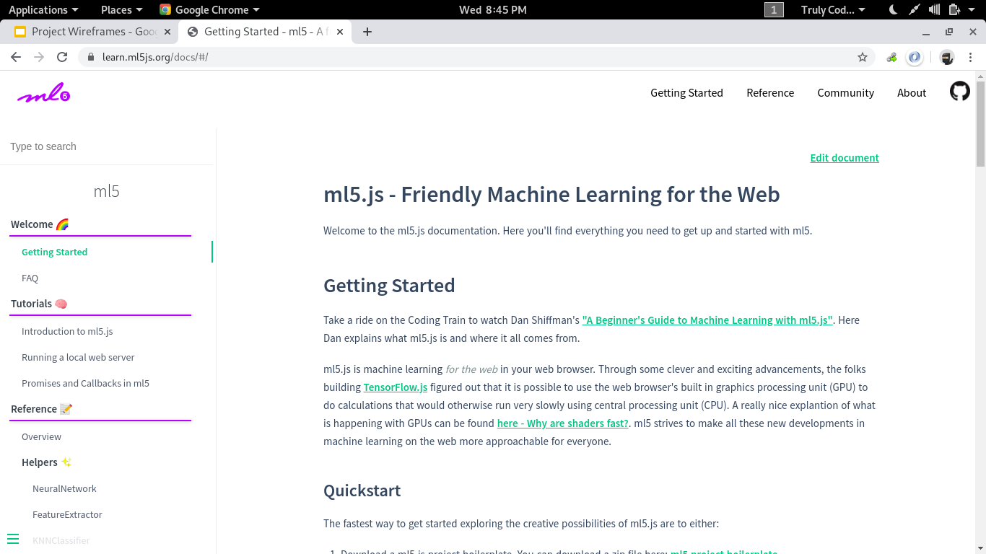

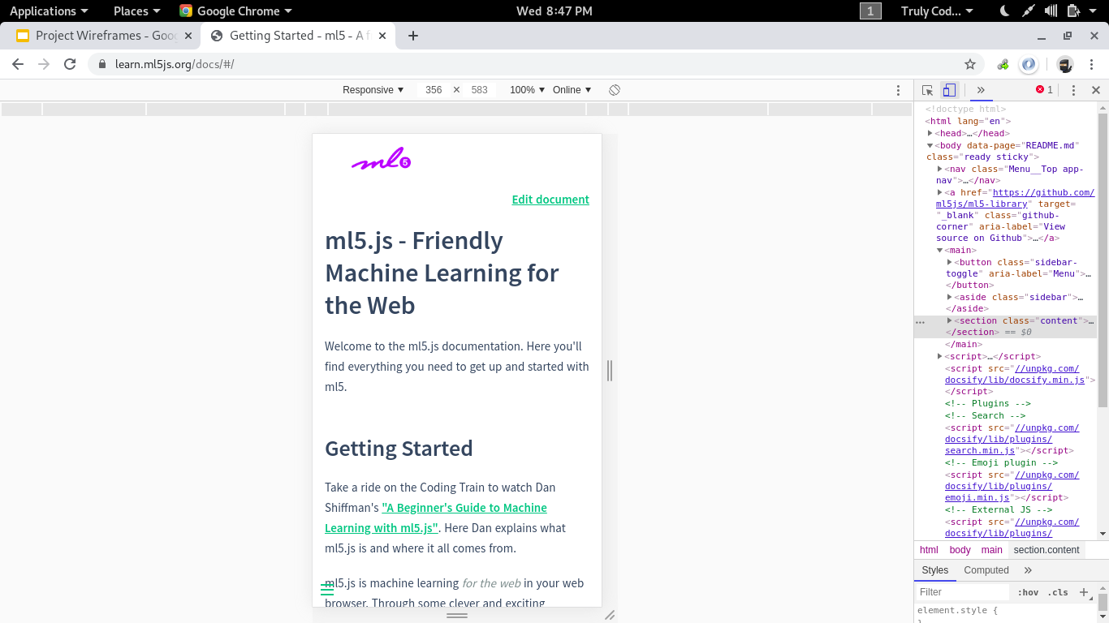
Artificial Intelligence
Don’t Ask How It just works...

Slide 2
A Little History
Introduced by Alan Turing during 1950s.
The term AI was first coined at Dartmouth conference, organised by John MacCarthy.
IBM’s deep blue the first computer to beat a human chess champion got its title on 10 February 1996.

Slide 3
WISDOM
It is the maturity of mind that directs intelligence to achieve desirable goal.
1
INTELLIGENCE
It is the ability to draw useful inferences from the available knowledge.
2
KNOWLEDGE
It is the processed from of information.
3
INFORMATION
Processed Data is termed information.
4
DATA
It is the collection of mere symbols which are the basic means of representation.
5

Slide 4

Turing Test
Catch me if you can...
Alan Turing
23 June 1912 to 7 June 1954
Turing defined intelligent behaviour as the ability to achieve human-level performance in all cognitive tasks, sufficiently to fool an interrogator.

Slide 5
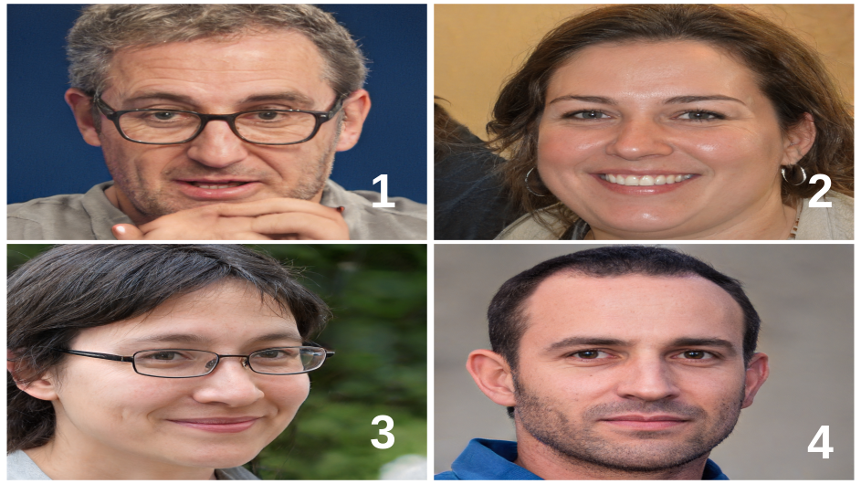

Slide 6
COMPONENTS OF AI
MACHINE LEARNING
Machine learning is an application of artificial intelligence (AI) that provides systems the ability to automatically learn and improve from experience without being explicitly programmed
NATURAL LANGUAGE PROCESSING
It is the ability of the computer to understand and use human language. Speech recognition, translation, OCR, sentimental analysis etc are some practical examples
04
01
03
KNOWLEDGE REPRESENTATION
Knowledge representation incorporates findings from psychology about how humans solve problems and represent knowledge in order to design formalisms that will make complex systems easier to design and build.
AUTOMATED REASONING
Automated reasoning is an area of cognitive science (involves knowledge representation and reasoning) and metalogic dedicated to understanding different aspects of reasoning.
02
Notes:
Use demo.

Slide 7
Artificial Neural Network
Artificial neural networks are computing systems vaguely inspired by the biological neural networks that constitute animal brains. Such systems "learn" to perform tasks by considering examples, generally without being programmed with task-specific rules
Evolutionary Computation
Evolutionary computation is a family of algorithms for global optimization inspired by biological evolution, and the subfield of artificial intelligence and soft computing studying these algorithms.
Computational Intelligence
Theory, design, application and design of biologically and linguistically motivated computational paradigms.
Swarm Intelligence
Swarm intelligence (SI) is the collective behavior of decentralized, self-organized systems. The expression was introduced by Gerardo Beni and Jing Wang in 1989, in the context of cellular robotic systems.
Fuzzy Systems
A fuzzy system is a control system that analyzes analog input values in terms of logical variables that take on continuous values between 0 and 1, in contrast to classical or digital logic, which operates on discrete values of either 1 or 0.

Slide 8
01
f(x) = e^x / ( 1+e^x )
Output values in the range (0 , 1)
Vanishing gradient
Outputs not zero centered
Computationally expensive
Smooth gradient
Sigmoid
02
f(x) = ( e^2x - 1 ) / ( e^2x + 1 )
Output values in the range (-1 , 1)
The function is differentiable
Mainly used classification between two classes
Computationally expensive
TanH
03
f(x) = max(0,x)
Computationally efficient
Output values in the range [0 , infinity)
Computationally efficient
Dying ReLU problem
Used along with Softmax
ReLU
04
f(x) = x if x >0 or ax if x <= 0
Output in the range (-infinity , infinity)
Prevents dying ReLU problem
Results not consistent
Leaky ReLU
05
f(x) = x*sigmoid(x)
Invented by Google brain team
Maintains gradient below zero
Used in deep Neural-Networks
0.6% to 0.9% more accurate than ReLU
Smooth gradient
Swish

Slide 9
Gradient Descent
A popular algorithm for machine learning.
Uses the concept of cost function.
Attempts to find a local minima.
Efficiency is probabilistic.

Slide 10
Applications Of Computational Intelligence
Classification
Regression
Feature Extraction
Generation
Detection

Slide 11
What next?
Improved Deep Learning.
Steps towards Unsupervised Learning.
Introduction of Transparent AI.
Personal AI.
General AI.

Slide 12
AI
Turing Test
CA
NLP
Knowledge Representation
Knowledge Representation
Automated Reasoning
Artificial Neural Network
Evolutionary Computation
Swarm Intelligence
Fuzzy System
Uses

Slide 13
References
NCERT +2 Computer Science Text Book
Wikipedia - Deep Blue (chess computer)
Wikipedia - Knowledge representation and reasoning
Wikipedia - Automated Reasoning
Expertsystems.com - What is Machine Learning? A definition
IEEE CIS - What is computational Intelligence ?

Slide 14
Resources
Google Slides : http://bit.ly/2NPWU19
Github : https://github.com/rohittp0/AI
Stack Overflow : https://stackoverflow.com/users/10182024/rohit

